Slide 1
EGC-211 L8: C++ inheritance part 2
T1-24-25
Ajay Bakre
Content Credit: Yashavant Kanetkar & Prof. Jaya Sreevalsan Nair

Slide 2
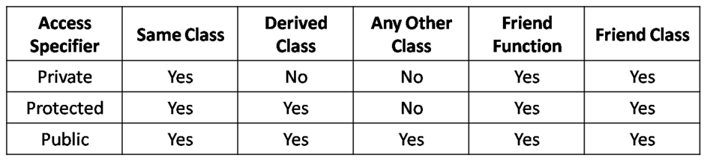
Access Control with Inheritance
Image Courtesy: http://www.startertutorials.com/blog/wp-content/uploads/2016/09/access-specifiers-in-cpp.png

Slide 3
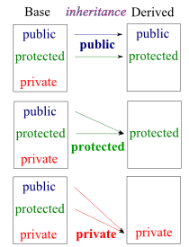
Modes of Inheritance
Public Inheritance
class Derived : public Base
No change in access control of Base class members in Derived class
Protected Inheritance
class Derived : protected Base
Public and protected members of Base class become protected in Derived class
Private Inheritance
class Derived : private Base
All members of Base class become private members in Derived class
Image courtesy: https://www.bogotobogo.com/cplusplus/multipleinheritance.php

Slide 4
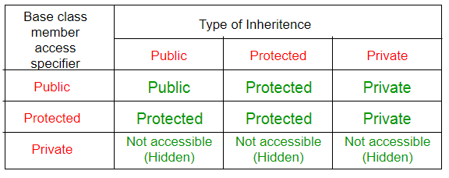
Summary of Inheritance in C++
Image courtesy: https://eng.libretexts.org/Courses/Delta_College/C_-_Data_Structures/04%3A_Inheritence/4.04%3A_Modes_of_Inheritance

Slide 5
Which Mode of Inheritance to Use?
Private inheritance is the default mode of inheritance
Needed in situations where a derived class object is defined “in-terms-of” the base class, but where composition cannot be used.
Public inheritance should be used to define an is-a relationship between a derived class and a base class (most commonly used)
A derived class object “is-a” base class object allowing the derived class object to be used polymorphically as a base class object in code that expects it
Protected inheritance is not widely used
May be useful when defining a base class that is itself a derived class and needs to make its base class members available to classes derived from itself

Slide 6
Access Control Example
class Index {
private :
int count ;
public :
Index( ) {
count = 0;
}
void display( ) {
cout << count ;
}
void operator ++ ( ) {
count ++ ;
}
};
class Index1 : public Index {
public :
void operator --( ) {
count-- ;
// undeclared variable count
}
};

Slide 7
Access Control Example contd
class Index {
protected :
int count ;
public :
Index( ) {
count = 0;
}
void display( ) {
cout << count ;
}
void operator ++ ( ) {
count ++ ;
}
};
class Index1 : public Index {
public :
void operator --( ) {
count -- ; // OK now
}
};
int main( ) {
Index i;
i.display( ) ; // i == 0
++i ; // i.operator ++( )
i.display( ) ; // i == 1
--i ; // no such operator
i.display( ) ; // i == 0
}

Slide 8
Access Control Example contd
class Index {
protected :
int count ;
public :
Index( ) {
count = 0;
}
void display( ) {
cout << count ;
}
void operator ++ ( ) {
count ++ ;
}
};
class Index1 : public Index {
public :
void operator --( ) {
count -- ; // OK now
}
};
int main( ) {
Index1 i;
i.display( ) ; // i == 0
++i ; // i.operator ++( )
i.display( ) ; // i == 1
--i ; // OK now
i.display( ) ; // i == 0
}

Slide 9
Which method gets called?
class Index {
protected :
int count ;
public :
Index( ) {
count = 0;
}
void display( ) {
cout << “Index=” << count ;
}
void operator ++ ( ) {
count ++ ;
}
};
class Index1 : public Index {
public :
void operator --( ) {
count -- ;
}
void display( ) {
cout << “Index1=” << count ;
}
};
int main( ) {
Index1 i;
i.display( ); // Index=0 or Index1=0?
}

Slide 10
Software Reuse with Inheritance
Use existing functionality
Override existing functionality
Provide new functionality
Combination of existing and new functionality

Slide 11
Software Reuse Example
A company has created software in C++ with several classes
It intends to create next version of the software
Following requirements have to be met in new version
A new Auto Update feature should be added
A defect was discovered while saving files > 400 kb
Data encryption function is too slow
While opening a file progress should also be displayed
Rest of the functionality is acceptable

Slide 12
Analyzing Requirements
A new Auto Update feature should be added
New – autoupdate()
Defect was discovered while saving files > 400 kb → fix it
Change - save( )
Data encryption function is too slow → fix it
Change - encrypt( )
While opening a file opening progress should be displayed
Combination - open( )
Rest of the functionality is acceptable
Use Existing - fun( )

Slide 13
Implementation
class Ex { // old version
public:
void fun() {
}
void save() {
}
void encrypt() {
}
void open() {
}
};
class NewEx : public Ex { // new version
public:
// fun() is inherited from parent
void save() { // fix defect here
}
void encrypt() { // make it fast
}
void open() {
// add progress bar
Ex::open(); /* call open() of
parent class */
}
};

Slide 14
Object Sizes
class Base {
private : int i ;
protected : int j ;
public : int k ;
} ;
class Der : public Base {
private : int x ;
protected : int y ;
public : int z ;
};
int main( ) {
Base bobj; Der dobj;
cout << sizeof ( bobj ) << sizeof ( dobj );
}
bobj
i
j
k
dobj
i
j
k
x
y
z
12 24

Slide 15
Order of Constructor Calls
Since a derived class object is constructed or built on top of the base class object
Base class object must be constructed before the derived class object is initialized
Constructor for derived class is responsible for proper initialization of data members in the base class
Problem with calling base class constructor from inside derived class constructor
Since the base class object must be created before derived class constructor is called, you cannot call the base class constructor inside the derived class
A base class initializer can be used to initialize the base class object instead
If no base class initializer is supplied, compiler inserts a default one
Only after the base class object is constructed successfully, data members of derived class are available for initialization

Slide 16
Calling Methods vs Constructors (1)
class Sample {
public :
void fun1( ) {
cout << "Hi" ;
}
};
class NewSample : public Sample {
public :
void fun1( ) {
cout << "Bye" ;
Sample :: fun1( ) ; // normal calling
}
};
int main() {
NewSample s;
s.fun1();
}
class Sample {
public :
Sample( ) {
cout << ”Sample’s Constructor" ;
}
};
class NewSample : public Sample {
public :
NewSample( ) {
Sample::Sample(); // Too late
cout << ”NewSample’s Constructor" ;
}
};
int main() {
NewSample s;
}

Slide 17
Calling Methods vs Constructors (2)
class Sample {
public :
void fun1( ) {
cout << "Hi" ;
}
};
class NewSample : public Sample {
public :
void fun1( ) {
cout << "Bye" ;
Sample :: fun1( ) ; // normal calling
}
};
int main() {
NewSample s;
s.fun1();
}
class Sample {
public :
Sample( ) {
cout << ”Sample’s Constructor" ;
}
};
class NewSample : public Sample {
public :
NewSample( ) : Sample() { // special way
cout << ”NewSample’s Constructor" ;
}
};
int main() {
NewSample s;
}

Slide 18
Constructors with Arguments
class Sample {
private :
int i ;
public :
Sample ( int j ) {
i = j;
}
} ;
class NewSample : public Sample {
public :
NewSample ( int k ) : Sample ( k ) {
}
} ;
int main () {
NewSample s(15);
}
If base class initializer is not explicitly called, compiler will insert a 0-arg constructor by default

Slide 19
Initializing Data Members
class Vehicle {
private :
int _mass;
public :
Vehicle ( int mass ) {
_mass = mass;
}
} ;
class LandVehicle : public Vehicle {
private :
int _speed;
public :
LandVehicle ( int mass, int speed ) :
Vehicle (mass), _speed (speed) {
}
} ;
int main () {
LandVehicle l_v (15, 20);
}
Initializer for base class object and data member of derived class object on a single line. Base class object must be initialized before data members of derived class obj.

Slide 20
Order of Destructor Calls
When an object is destroyed or goes out of scope, destructors are automatically called
When an object of a derived class is destroyed or goes out of scope
The destructor of derived class is called first
The destructor of base class is called afterwards
Order of destruction is the opposite of order of construction

